Slide 1
Goodbye Violetta
Violetta is on the way to England

Slide 2
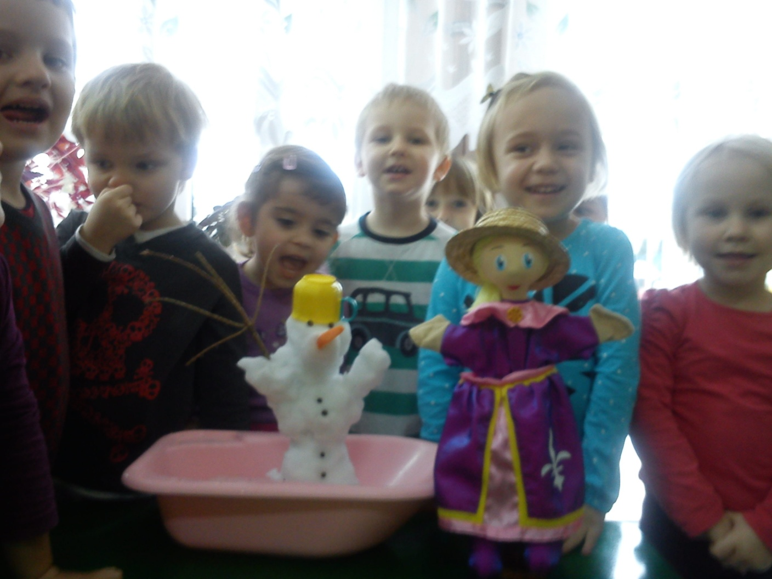
Violetta discovers the winter in Poland

Slide 3
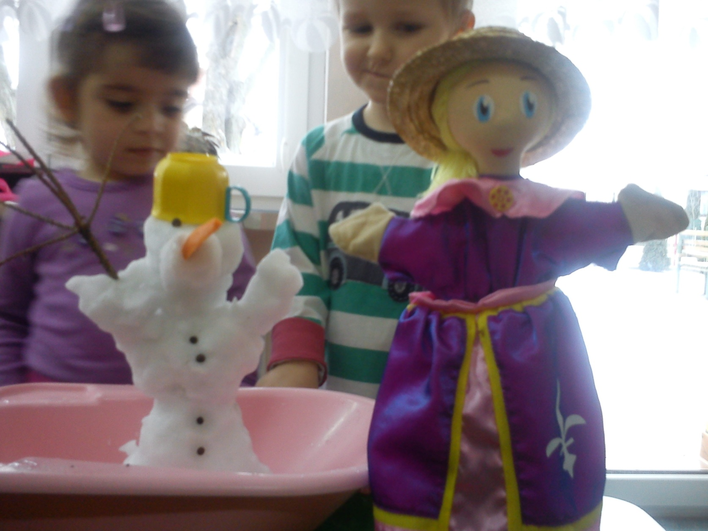

Slide 4
